Slide 1



Sathishkumaravi29@gmail.com
Web Presence
Project
Crafting & Compelling Website Analysis,Audit and Recommendations
Presented By:
Presented To:
R.SATHISH KUMAR
MBT11
GUVI

Slide 2
Task
1
Company Selection
Product and Services Descriptions
Website Platform Identification
Responsive Design Testing
5
Website Mistakes Identtification
Website Best Practices List
Landing Page Design
Conclusion
2
6
3
7
4
8

Slide 3

Task-1 : Company Selection
I selected the company “Intellect” for this Web Presence Project.
About Intellect :
Intellect Design Arena delivers cutting-edge fintech solutions for banks and financial institutions globally
They emphasize digital transformation using AI-powered, cloud-native, and API-first technologies.
Their products cater to corporate and consumer banking, focusing on modernizing financial services with customer-centric solutions.

Slide 4
Task-2 : Product and Services Descriptions
AI Products : Intellect offers a comprehensive suite of ai-driven products and data insights to address key challenges in the financial and insurance industries.
Magic Submission : Streamlines document submission and data processing through automation.
Risk Analyst : Provides in-depth risk analysis and decision-making support using AI.
Wealth Qube : A digital wealth management platform offering portfolio insights and analytics.
WealthForce.AI : Enhances wealth advisory services with AI-driven recommendations.
Insurance : Comprehensive insurance solutions for modernizing and optimizing services.
Esg Edge : Focuses on environmental, social, and governance analytics for financial compliance and strategy.

Slide 5
Digital Technology for Commerce : Intellect's digital commerce solutions streamline payment processing, digital transactions, and e-commerce ecosystems, designed to integrate seamlessly with various financial platforms. Intellect's digital commerce solutions provide robust security features, ensuring safe and compliant transaction handling across e-commerce platforms. These solutions enable businesses to scale quickly, offer personalized customer experiences, and integrate easily with existing financial systems for seamless operations.
Account payable exchange
Corporate Procurement Exchange
Government Procurement Exchange
Six Dimensions of Retail Experience

Slide 6
Corporate banking : intellect provides corporate banking solutions focused on cash management, trade finance, lending, and treasury, helping businesses manage financial operations efficiently through advanced, scalable platforms.
Virutal Account
Payments Solution
PayCash - CX
Corporate Banking
Contextual banking experience
Corporate Treasury Exchange
Digital Transcation Banking (DTB)

Slide 7
Task-3 : Website Platform Identification
Platform : The website is developed on Workpress plugin,HTML,XHTML,CSS

Slide 8
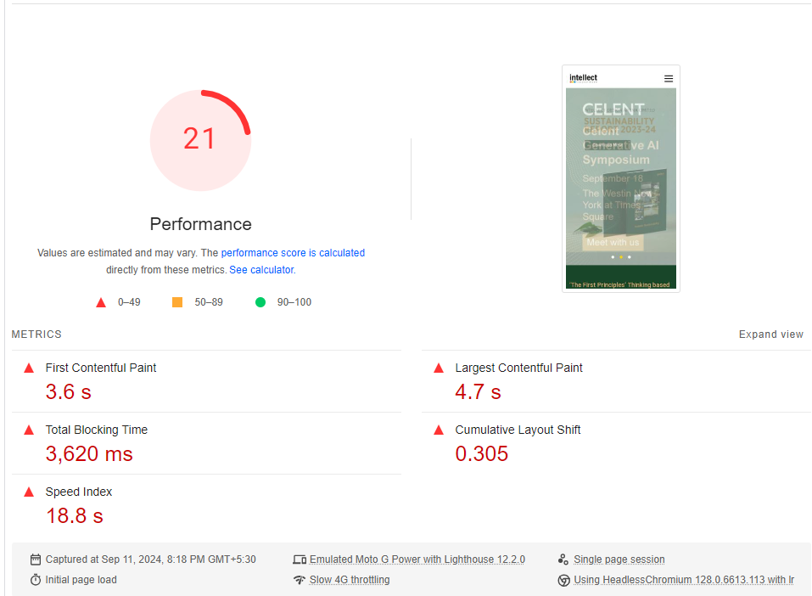
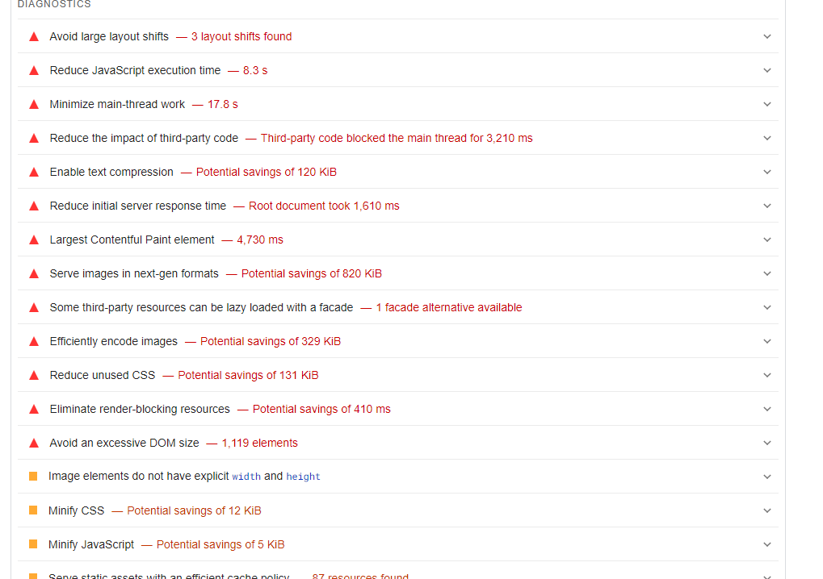
Task-4 : Responsive Digital Test
Tools Used : Google Mobile friendly , GT Metrix , Pagespeed.
Homepage : The homepage is optimized for mobile users, but there might be minor issues related to layout alignment. The content adapts well across various devices, though some areas could benefit from fine-tuning for a smoother experience.

Slide 9
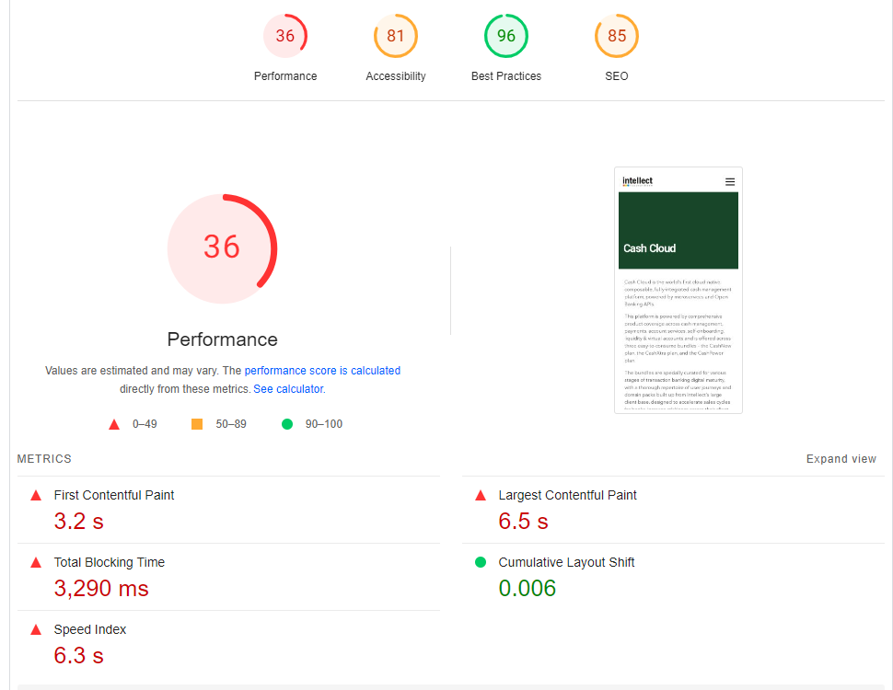
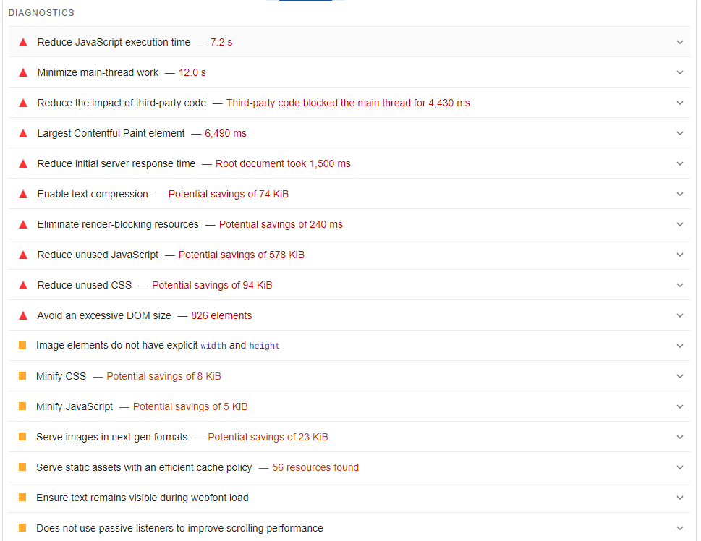
Services Page : This page performs decently in terms of responsiveness, but it could use improvements in image optimization to enhance loading speed and visual clarity on smaller screens..

Slide 10
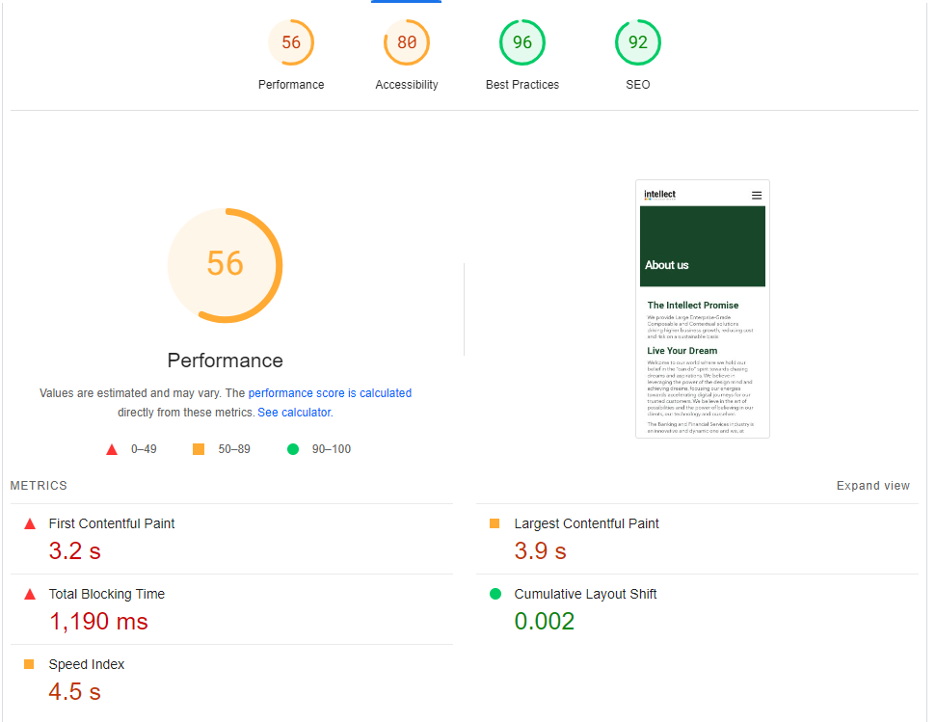
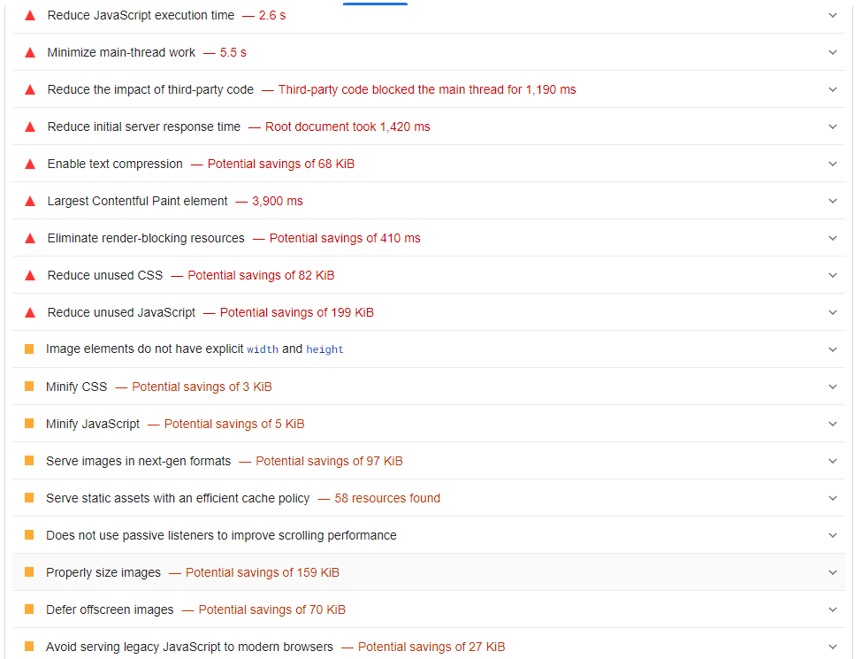
About Us Page: The "About Us" section is well-optimized for mobile usage. However, increasing the text size might improve readability, especially on smaller devices.

Slide 11
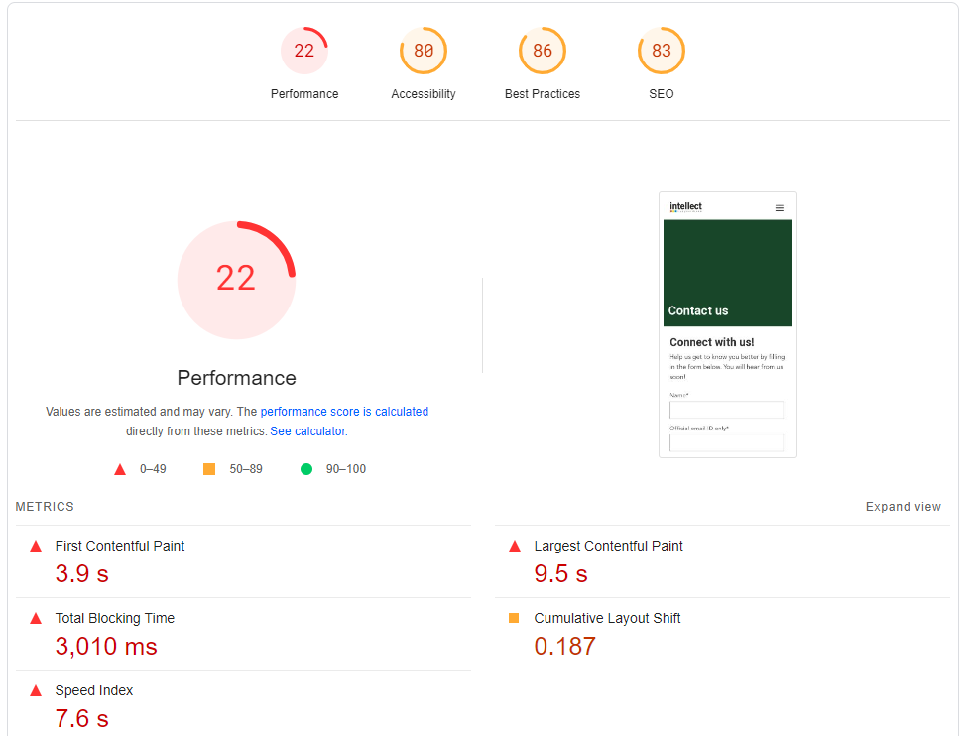
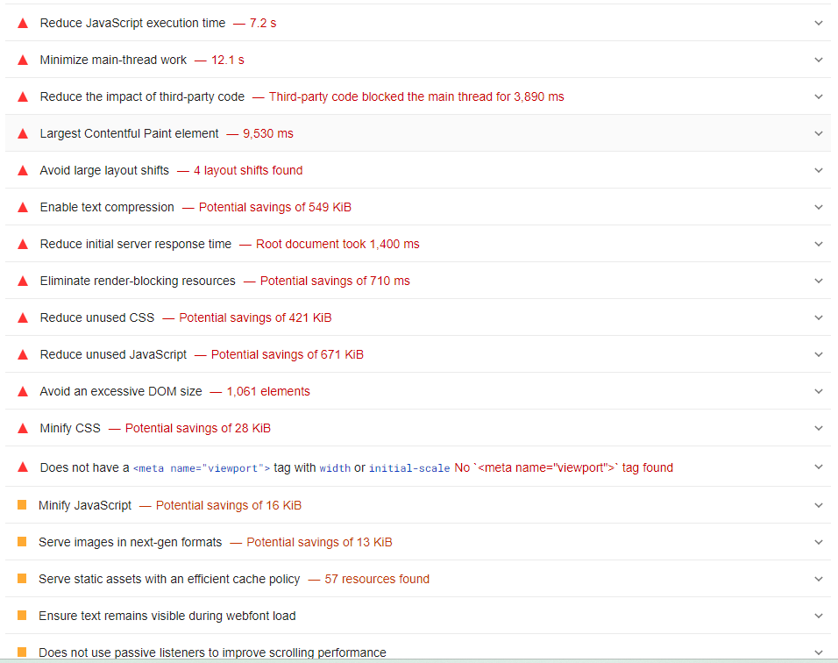
Contact Page : The Contact Page of the Intellect Design website has poor performance, with a score of 22/100. It takes nearly 4 seconds for the first content to appear and over 9 seconds for the main content to fully load, which is quite slow.

Slide 12
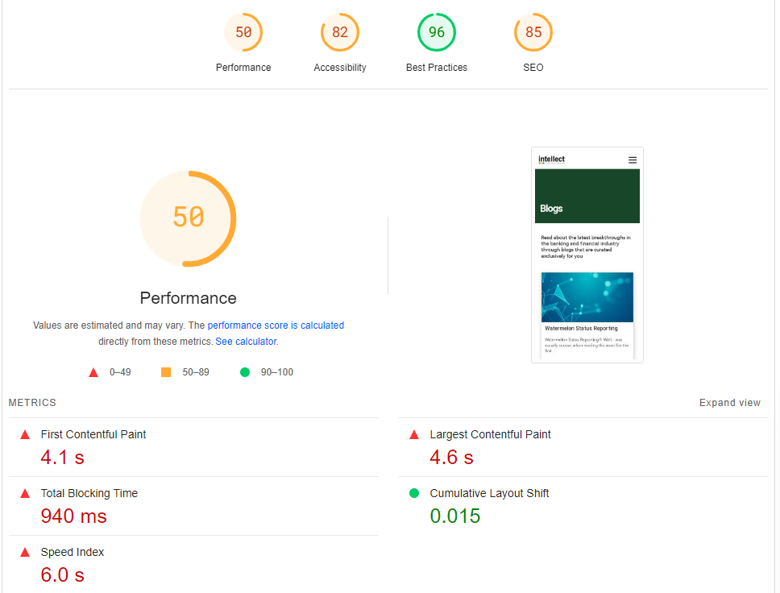
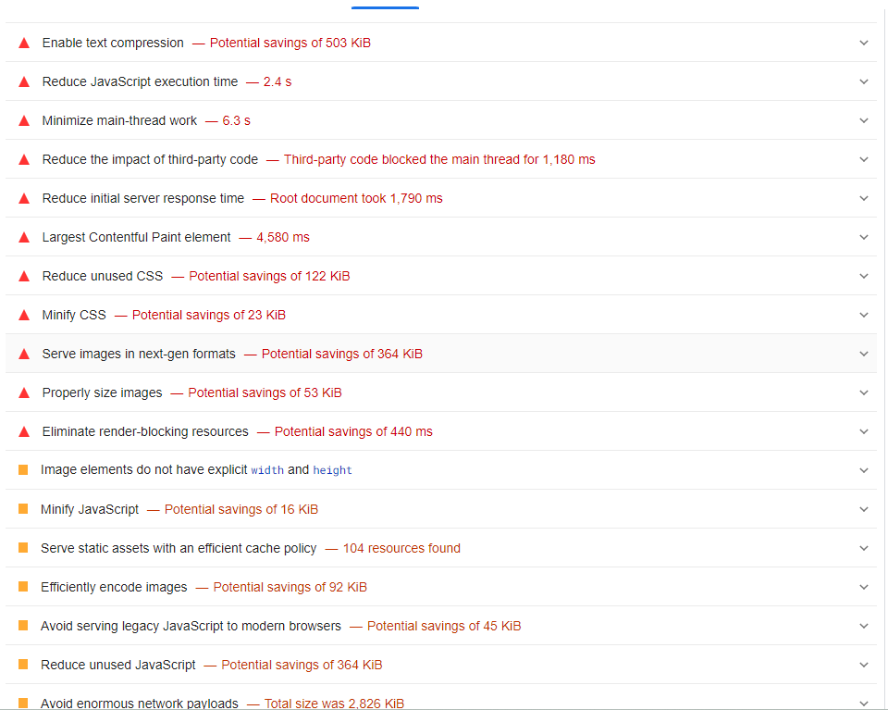
Blog Page : The Blog Page of the Intellect Design website has a moderate performance score of 50/100. It takes around 4.1 seconds for the first content to appear and 4.6 seconds for the main content to load, which is not too slow but could still be improved. The total blocking time is 940 milliseconds, meaning the page is generally responsive, though there is still room for improvement in loading time. The speed index is 6 seconds, which is slightly higher than recommended. The page has a good Cumulative Layout Shift of 0.015, meaning the layout is stable and doesn't shift much as it loads.

Slide 13
Task-5 : Website Mistakes Identification
Overloaded Technical Jargon : The site uses a lot of technical language (e.g., "MACH-enabled" and "API-first") without adequate explanation, which may confuse non-expert visitors.
Navigation Complexity: The large number of categories and products listed could overwhelm users, making it harder to find specific information.
Load Times: Heavy graphical elements and animations might slow down loading times, affecting usability.
Mobile Optimization: The website’s responsiveness on smaller devices can be improved for better accessibility.

Slide 14
Task-6 : Website Best Practices List
Clear Value Proposition : The website effectively communicates its services and innovations, which quickly informs visitors about what the company offers.
Responsive Design : The site is optimized for various screen sizes, offering a seamless experience across devices.
Fast Load Times : Efficient content delivery ensures that the site loads quickly.
Intuitive Navigation : Categorized menu options allow users to easily find product or service-related information.
Visual Appeal : The site uses a clean, professional design with engaging visuals.

Slide 15
Task-7 : Landing Page Design
Objectives : The objectives of the landing page are to generate leads for blockchain solutions by showcasing the value and benefits of blockchain technology, building trust through client testimonials, and encouraging conversions with strong calls-to-action.
Design Features :
Hero Section : A visually compelling hero image or graphic that presents a clear and concise value proposition, highlighting how blockchain solutions can benefit the user.
Social Proof : Display client testimonials, success stories, or notable client logos to enhance trust and credibility.
Interactive Lead Capture Forms : Simple, user-friendly forms placed strategically on the page to make it easy for visitors to sign up, request demos, or get more information.

Slide 16
Task-7 : Landing Page Design
Blockchain Overview : A brief but informative section that explains the key benefits of blockchain technology in various sectors
Strong CTAs : Visible and strategically placed buttons (e.g., "Get Started," "Request a Demo," "Learn More") to drive conversions.
Mobile-Optimized : Ensure that the landing page is fully responsive and works seamlessly on mobile devices, catering to on-the-go users.
Fast Load Time : Optimize for quick loading to reduce bounce rates and improve user experience.
Landing Page – Click Here

Slide 17
Conclusion :
This project has effectively highlighted the critical components of digital marketing and website design, with a focus on establishing a robust and engaging online presence for Intellect Design.
By leveraging fundamental digital marketing strategies, adhering to key design principles, and implementing best practices, I have developed a landing page that prominently features Intellect Design's innovative solutions.
The goal is to enhance brand visibility, drive lead generation, and bolster overall engagement.
The insights and recommendations provided are aimed at driving continuous improvement and optimizing Intellect Design's digital presence to achieve sustained success and growth in the competitive landscape.

